Slide 1
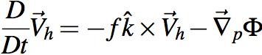
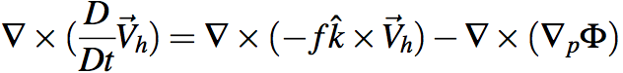
Holy grail of dynamics: get div & ω
Gotta avoid dragging thermo into this via Φ.
Get rid of Φ at any cost. Curl to the rescue!
Ker-CHING!
We are Masters of the Universe with our sexy vector identities!
The grail is in the bag!
Notes:
\nabla \times (\frac{D}{Dt} \vec V_h) = \nabla \times (-f \hat k \times \vec V_h) - \nabla \times (\nabla_p \Phi)

Slide 2
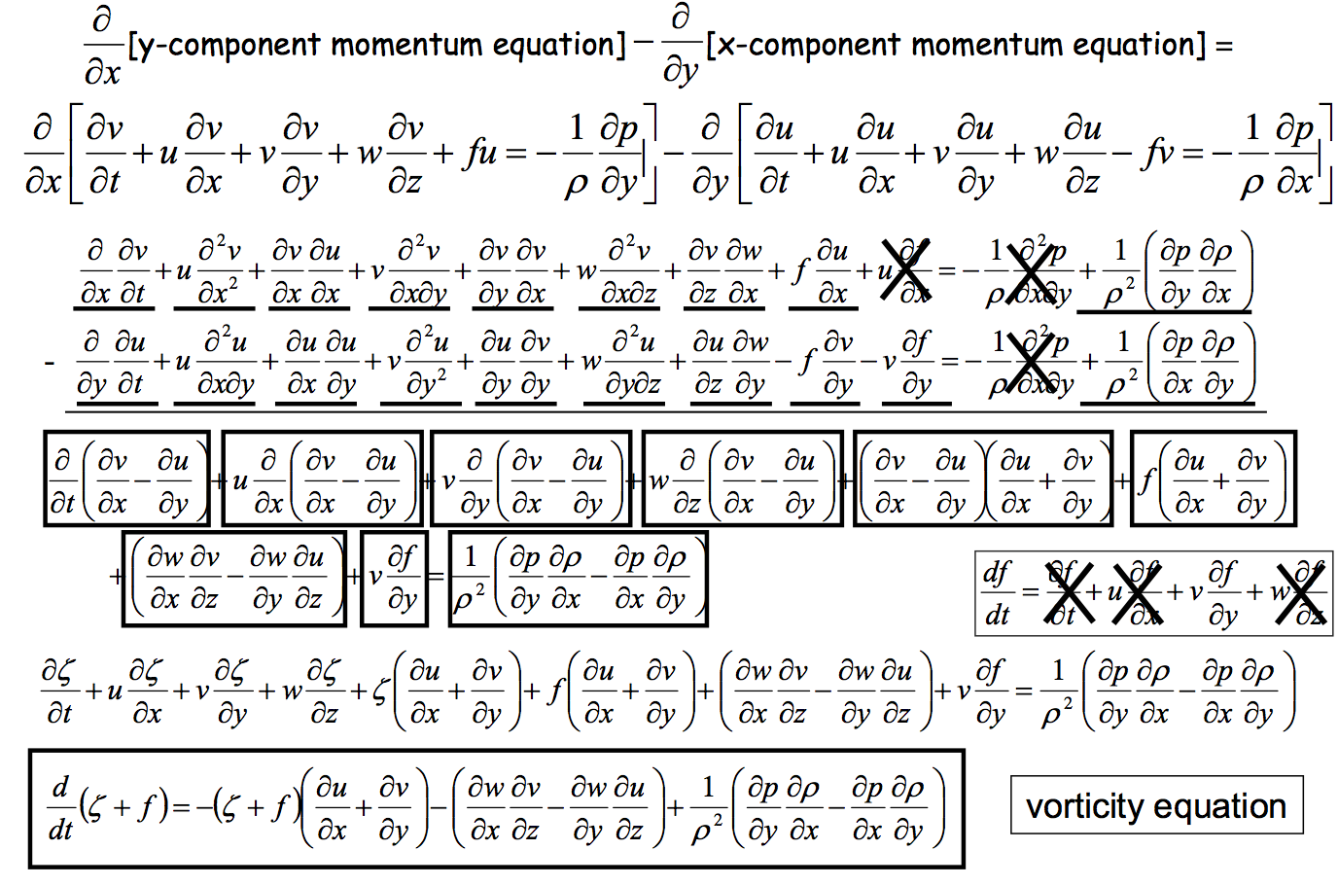
Heh heh ... did I say "any cost"... ? gulp
Can we scrape back some of these cobwebs?
Wait a sec, what's this??

Slide 3
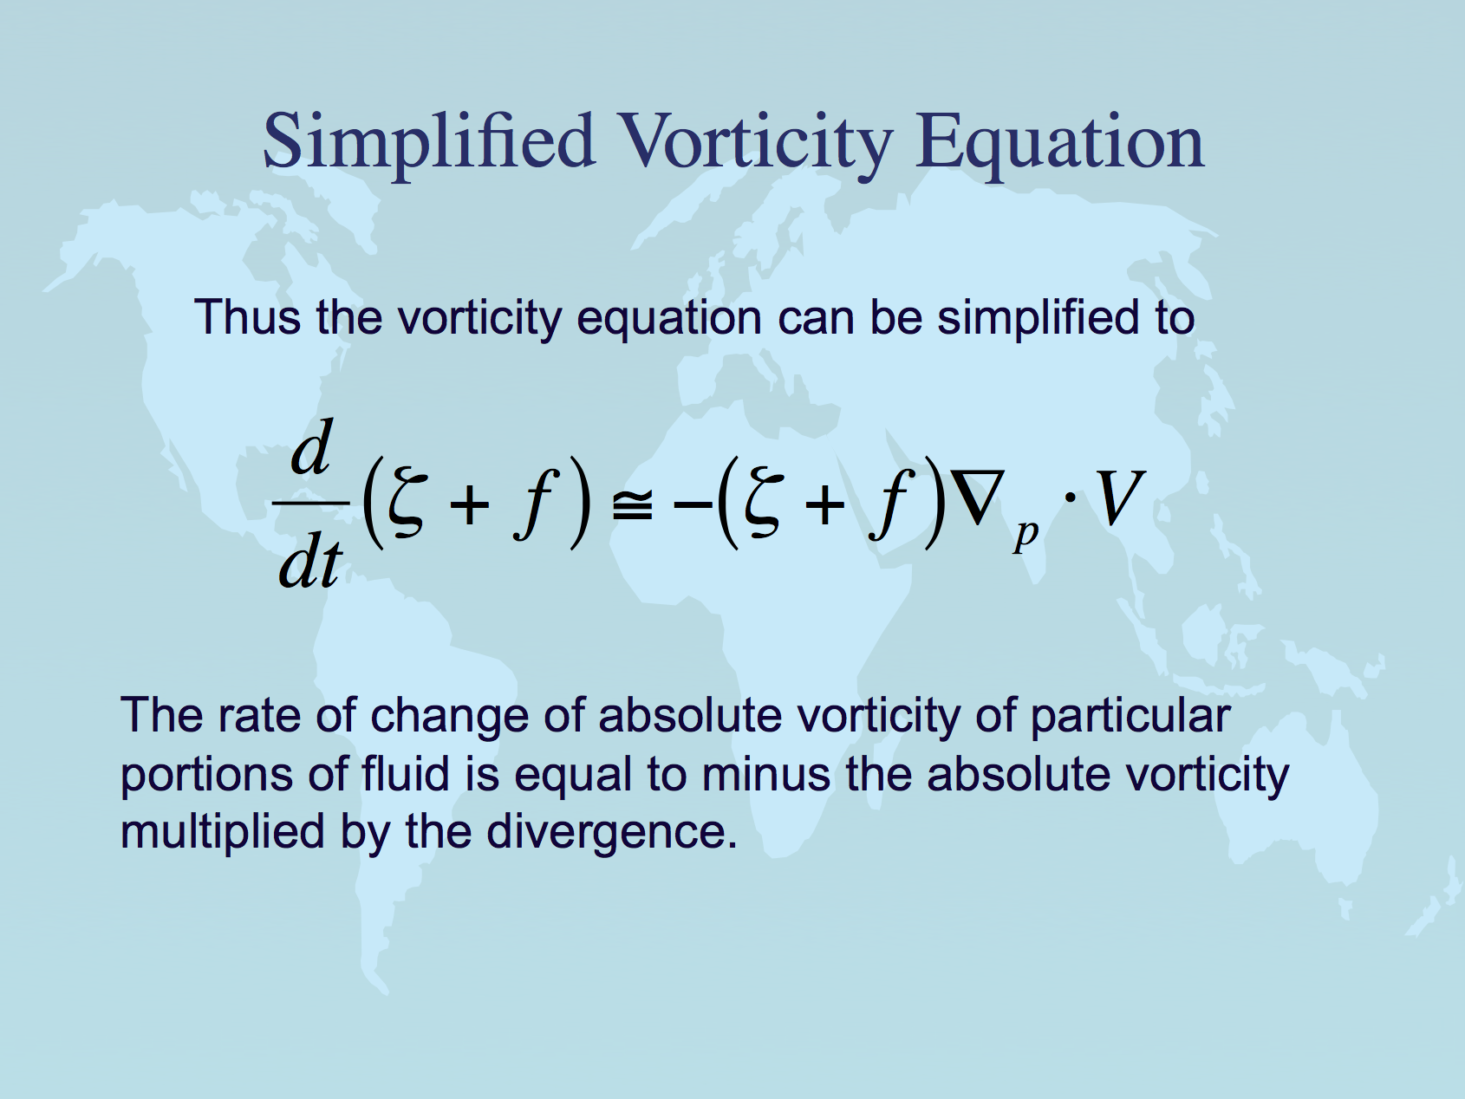
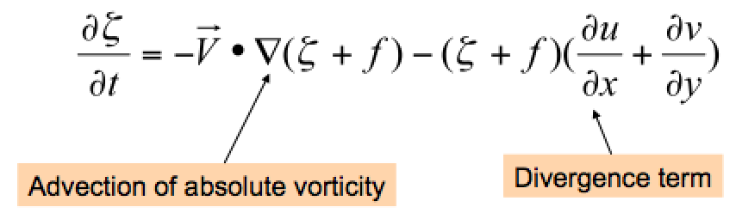
Same equation in Eulerian (local rate of change with time) form.
Lackmann Eq. 1.51

Slide 4
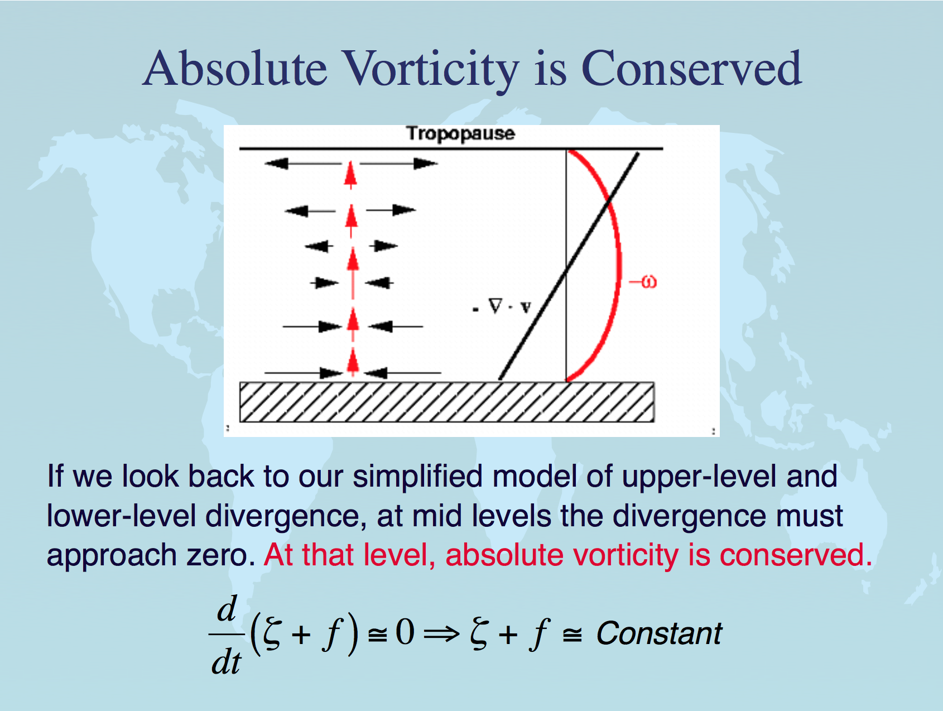
almost,
at midlevels
especially

Slide 5
Conservation of absolute vorticity: how?
When air moves north or south, it tends to conserve its absolute vorticity -- or in other words it converts planetary to relative vorticity. How?
Consider equatorward motion of a disc of fluid.
The initially high f = ζ_{plan} is converted to ζ_{rel}. How?
Physically, the Coriolis force fv is a little bit stronger on its poleward edge (where f is bigger) than on its equatorward edge. This imparts a cyclonic torque on the disk of fluid as it moves southward.
fv
v
All v winds the same, as the disk
moves southward as a unit →
(an eastward PGF must balance the mean Coriolis force, to keep the air flowing southward)
v
fv
v
v
Notes:
\frac {D\zeta_{abs}} {Dt} \simeq 0
\frac {\partial \zeta_{abs}} {\partial t} \simeq -\vec V \cdot \vec \nabla_p \zeta_{abs} - \omega \frac {\partial \zeta_{abs}} {\partial p}

Slide 6
p surfaces on a z-coordinate diagram
for NH westerly jet stream in thermal wind balance
→
z
150 mb
thinner mass (Δp) layers,
cooler compared to
← that
big thickness of mass (Δp)
layers: warm compared to that →
200 mb
300 mb
Jet stream
into page
PGF is “downhill”
Coriolis force to R
500 mb
small thickness of
mass (Δp) layers:
cooler, compared to that→
same mass (Δp) layers
are thicker: warmer than
← that
700 mb
1000 mb
North
South

Slide 7
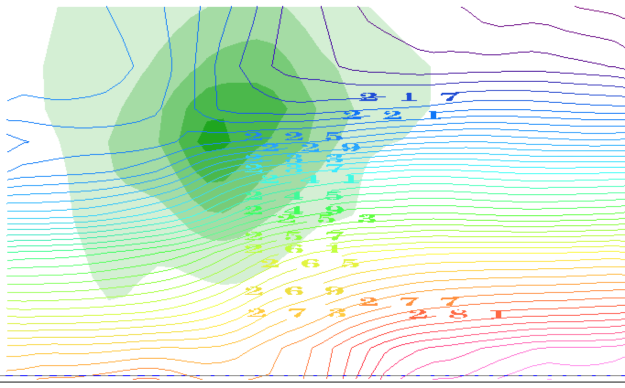
contours of T(K): it decreases with height
(plus the horizontal gradients due to TWB)
thinner mass (Δp) layers,
cooler compared to
← that
big thickness of mass (Δp)
layers: warm compared to that →
small thickness of
mass (Δp) layers:
cooler, compared to that→
same mass (Δp) layers
are thicker: warmer than
← that
North
South

Slide 8
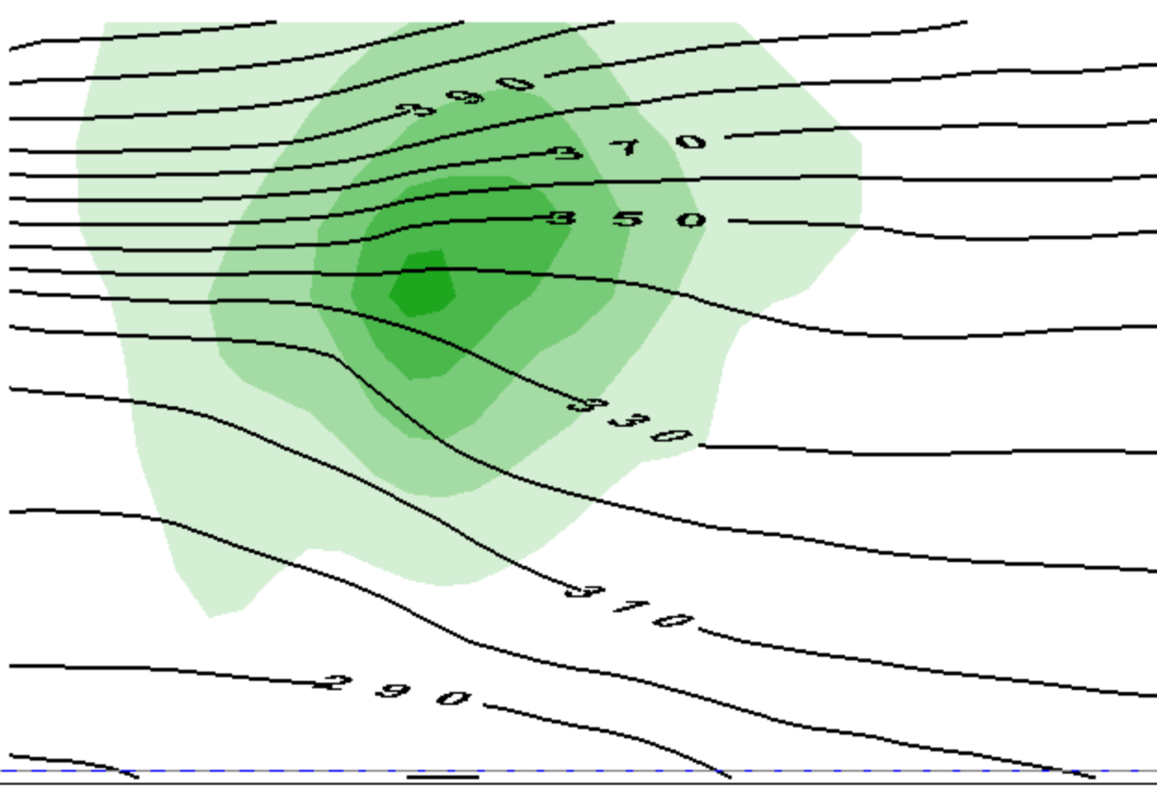
contours of θ(Κ): it increases with height
(plus the horizontal gradients due to TWB)
thinner mass (Δp) layers,
cooler compared to
← that
big thickness of mass (Δp)
layers: warm compared to that →
small thickness of
mass (Δp) layers:
cooler, compared to that→
same mass (Δp) layers
are thicker: warmer than
← that
North
South

Slide 9
This is only half the story of a vortex
cooler than
← that
warmer than
that →
cooler than
that→
warmer than
← that

Slide 10
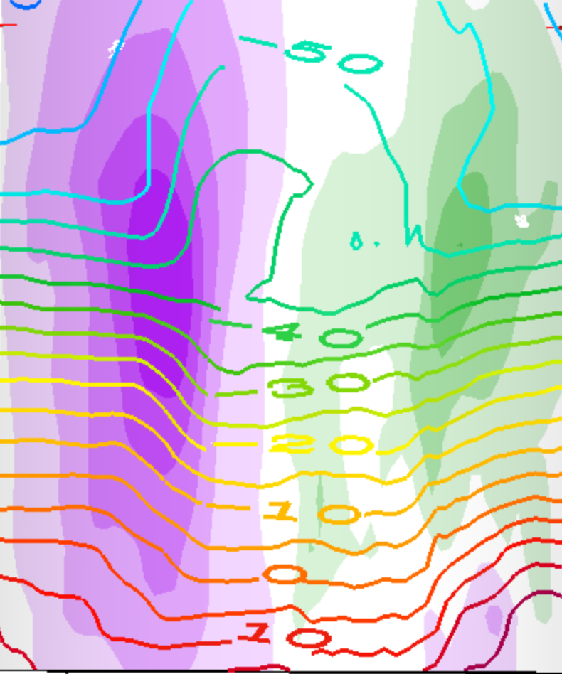
This is a whole vortex (two jets)
T(K) contours
cooler than
that →
warmer than
← that
cooler than
← that
warmer than
that →
warmer than
that →
cooler than
← that
cooler than
that→
warmer than
← that

Slide 11
This is a whole vortex (two jets)
T(K) contours
warmer than
← that →
above the core
cooler than
← that →
below the core

Slide 12
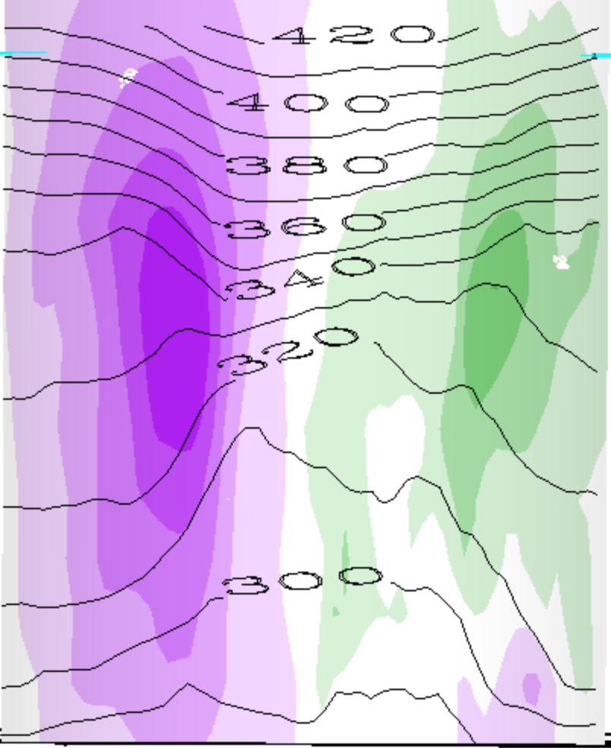
This is a whole vortex (two jets)
θ(K) contours
warmer than
← that →
above the cyclone
cooler than
← that →
below the cyclone

Slide 13
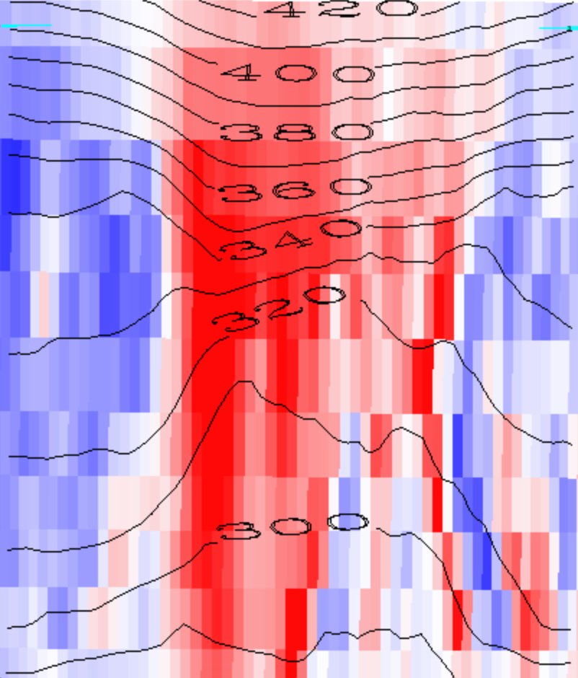
Red is positive vorticity , θ(K) contours
warmer than
← that →
above the cyclone
cooler than
← that →
below the cyclone

Slide 14
Red is positive vorticity , θ(K) contours
warmer than
← that →
above the cyclone
Cyclonic Vortex
cooler than
← that →
below the cyclone

Slide 15
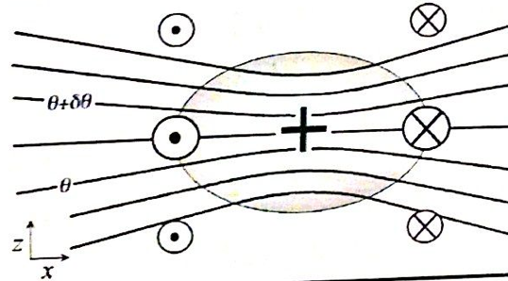
Generalization: PV
1. We will see that every cyclonic vortex obeying vertical (hydrostatic) and horizontal (geostrophic or other) balance looks similar to this (maybe stretched or shrunk):
PV > 0

Slide 16
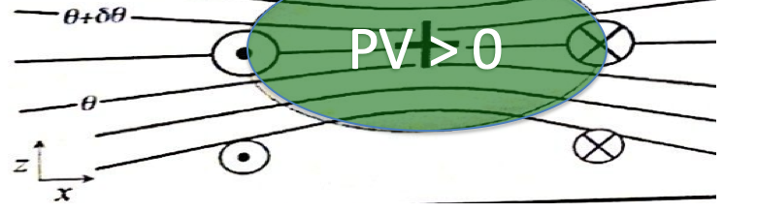
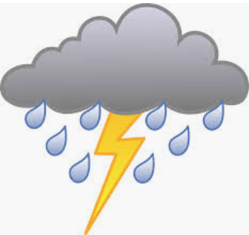

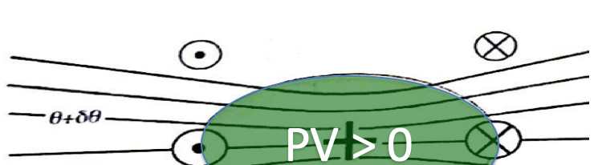
Since our main weather concern is in the lower troposphere (where water is),
This is called a cool core cyclone:
This is called a warm core cyclone:

Slide 17
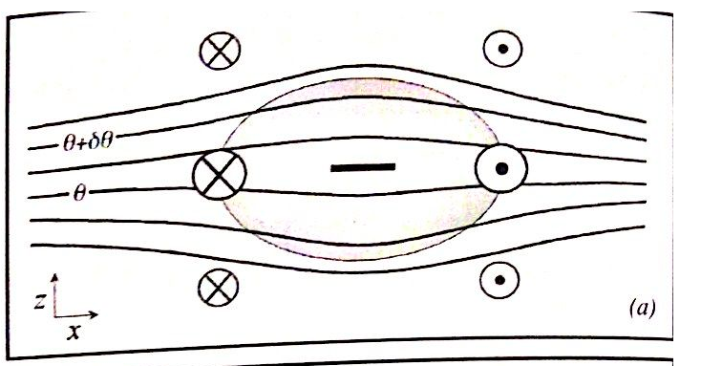
Balanced anticyclones exist too...
Just the opposite of a cyclone...
PV < 0

Slide 18
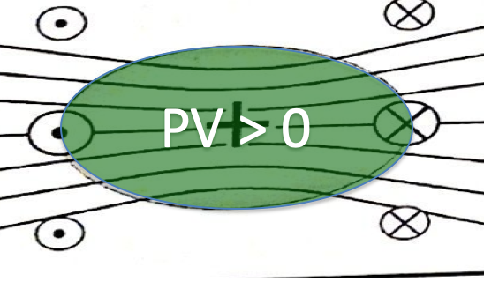
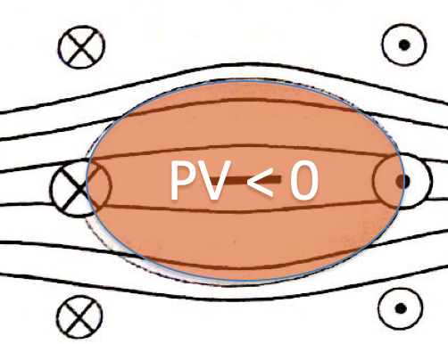
Vorticity (or PV) blobs
Where do they come from?
How do they interact?
(this we studied, in the horizontal plane)
Do they get destroyed?
(Soon: tackling the complications)

Slide 19
IDV lab assignment -- part 1
In the following slides, make and label and explain nice clear illustrations like slides 13-17, but for
a warm core anticyclone
a warm core cyclone
a cool core anticyclone

Slide 20
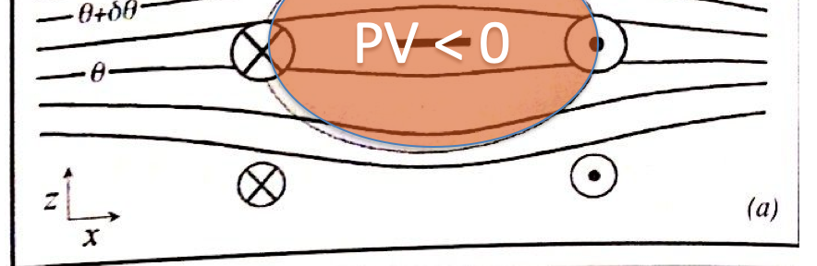
A warm core anticyclone
Where? Describe the situation.

Slide 21
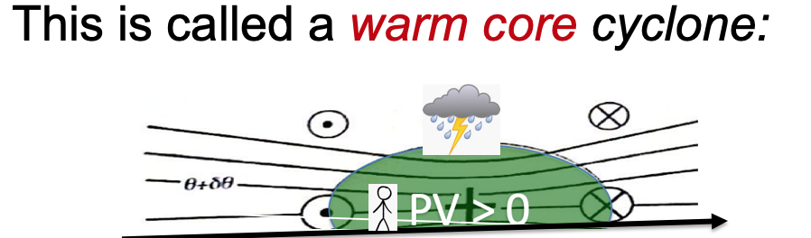
A warm core cyclone
Where? Describe the situation

Slide 22
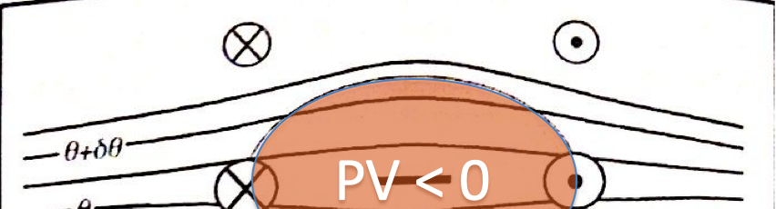
A cool core anticyclone
Where? Describe the situation

